Slide 1
Blacktown Chinese Christian Church
Welcome to Our English Service
13.09.2026
English Service 9:45 – 11:00 am
Worship Songs:
Passage:
Speaker:
Topic:
Response Song:
Announcements and Closing Prayer
Benediction
God Is For Us
A Thousand Hallelujahs
This I Believe
Build My Life (response)
Eph 4:12-16
Xavier Lakshmanan
Aims of the Growing Church

Slide 2
BCCC english service

Slide 3
God Is For Us
CCLI Licence No: 5485849

Slide 4
We won't fear the battle, we won’t fear the night
We will walk the valley with You by our side
You will go before us, You will lead the way
We have found a refuge, only You can save

Slide 5
Sing with joy now: our God is for us
The Father's love is a strong and mighty fortress
Raise your voice now, no love is greater
Who can stand against us if our God is for us

Slide 6
Even when I stumble, even when I fall
Even when I turn back, still Your love is sure
You will not abandon, You will not forsake
You will cheer me onward with never-ending grace

Slide 7
Sing with joy now: our God is for us
The Father's love is a strong and mighty fortress
Raise your voice now, no love is greater
Who can stand against us if our God is for us

Slide 8
Neither height nor depth can separate us
Hell and death will not defeat us
He who gave His son to free us
Holds me in His love

Slide 9
Neither height nor depth can separate us
Hell and death will not defeat us
He who gave His son to free us
Holds me in His love

Slide 10
Sing with joy now: our God is for us
The Father’s love is a strong and mighty fortress
Raise your voice now, no love is greater
Who can stand against us if our God is for us

Slide 11
Sing with joy now: our God is for us
The Father's love is a strong and mighty fortress
Raise your voice now, no love is greater
Who can stand against us if our God is for us

Slide 12
A Thousand Hallelujahs
CCLI Licence No: 5485849

Slide 13
Who else would rocks cry out to worship?
Whose glory taught the stars to shine?
Perhaps creation longs to have the words to sing
But this joy is mine

Slide 14
With a thousand hallelujahs
We magnify Your name
You alone deserve the glory
The honor and the praise

Slide 15
Lord Jesus
This song is forever Yours
A thousand hallelujahs
And a thousand more

Slide 16
Who else would die for our redemption?
Whose resurrection means I’ll rise?
There isn’t time enough to sing of all You’ve done
But I have eternity to try

Slide 17
With a thousand hallelujahs
We magnify Your name
You alone deserve the glory
The honor and the praise

Slide 18
Lord Jesus
This song is forever Yours
A thousand hallelujahs
And a thousand more

Slide 19
Praise to the Lord
To the lamb
To the King of Heaven

Slide 20
Praise for He rose
Now He reigns
We will sing forever

Slide 21
Praise to the Lord
To the lamb
To the King of Heaven

Slide 22
Praise for He rose
Now He reigns
We will sing forever

Slide 23
With a thousand hallelujahs
We magnify Your name
You alone deserve the glory
The honor and the praise

Slide 24
Lord Jesus
This song is forever Yours
A thousand hallelujahs
And a thousand more

Slide 25
Praise to the Lord
To the lamb
To the King of Heaven

Slide 26
Praise for He rose
Now He reigns
We will sing forever

Slide 27
With a thousand hallelujahs
We magnify Your name
You alone deserve the glory
The honor and the praise

Slide 28
Lord Jesus
This song is forever Yours
A thousand hallelujahs
And a thousand more

Slide 29
This I Believe
CCLI Licence No: 5485849

Slide 30
Our Father everlasting
The all-creating One
God Almighty

Slide 31
Through your Holy Spirit
Conceiving Christ the Son
Jesus our Saviour

Slide 32
I believe in God our Father
I believe in Christ the Son
I believe in the Holy Spirit
Our God is three in One

Slide 33
I believe in the resurrection
That we will rise again
For I believe in the Name of Jesus

Slide 34
Our Judge and our Defender
Suffered and crucified
Forgiveness is in You

Slide 35
Descended into darkness
You rose in glorious light
Forever seated high

Slide 36
I believe in God our Father
I believe in Christ the Son
I believe in the Holy Spirit
Our God is three in One

Slide 37
I believe in the resurrection
That we will rise again
For I believe in the Name of Jesus

Slide 38
I believe in You
I believe You rose again
I believe that Jesus Christ is Lord
(x2)

Slide 39
I believe in life eternal
I believe in the virgin birth
I believe in the saints' communion
And in Your Holy Church

Slide 40
I believe in the resurrection
When Jesus comes again
For I believe in the Name of Jesus

Slide 41
I believe in God our Father
I believe in Christ the Son
I believe in the Holy Spirit
Our God is three in One

Slide 42
I believe in the resurrection
That we will rise again
For I believe in the Name of Jesus

Slide 43
For I believe in the Name of Jesus
For I believe in the Name of Jesus

Slide 44
Build My Life
CCLI Licence No: 5485849

Slide 45
Worthy of every song we could ever sing
Worthy of all the praise we could ever bring
Worthy of every breath we could ever breathe
We live for You

Slide 46
Jesus, the name above every other name
Jesus, the only one who could ever save
Worthy of every breath we could ever breathe
We live for You

Slide 47
Holy, there is no one like You
There is none beside You
Open up my eyes in wonder

Slide 48
Show me who You are
And fill me with Your heart
And lead me in Your love to those around me

Slide 49
Worthy of every song we could ever sing
Worthy of all the praise we could ever bring
Worthy of every breath we could ever breathe
We live for You

Slide 50
Jesus, the name above every other name
Jesus, the only one who could ever save
Worthy of every breath we could ever breathe
We live for You

Slide 51
Holy, there is no one like You
There is none beside You
Open up my eyes in wonder

Slide 52
Show me who You are
And fill me with Your heart
And lead me in Your love to those around me

Slide 53
Holy, there is no one like You
There is none beside You
Open up my eyes in wonder

Slide 54
Show me who You are
And fill me with Your heart
And lead me in Your love to those around me

Slide 55
I will build my life upon Your love
It is a firm foundation
I will put my trust in You alone
And I will not be shaken (x2)

Slide 56
Holy, there is no one like You
There is none beside You
Open up my eyes in wonder

Slide 57
Show me who You are
And fill me with Your heart
And lead me in Your love to those around me

Slide 58
Holy, there is no one like You
There is none beside You
Open up my eyes in wonder

Slide 59
Show me who You are
And fill me with Your heart
And lead me in Your love to those around me

Slide 60
I will build my life upon Your love
It is a firm foundation
I will put my trust in You alone
And I will not be shaken

Slide 61
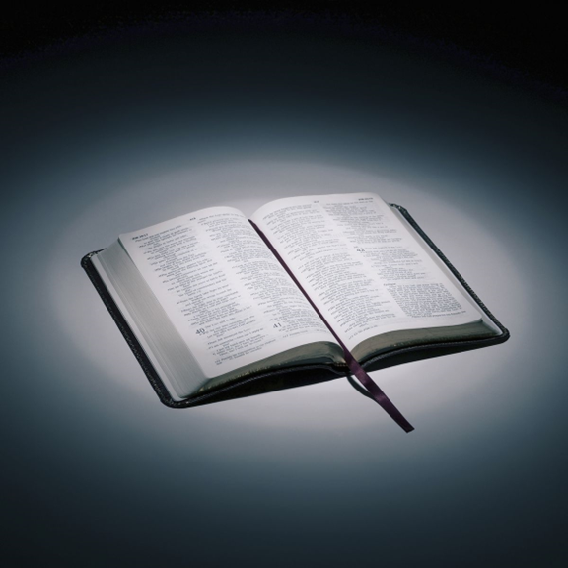
Bible reading

Slide 62
Eph 4:12-16
¹² to equip his people for works of service, so that the body of Christ may be built up ¹³ until we all reach unity in the faith and in the knowledge of the Son of God and become mature, attaining to the whole measure of the fullness of Christ.

Slide 63
Eph 4:12-16
¹⁴ Then we will no longer be infants, tossed back and forth by the waves, and blown here and there by every wind of teaching and by the cunning and craftiness of people in their deceitful scheming. ¹⁵ Instead, speaking the truth in love, we will grow to become in every respect the mature body of him who is the head, that is, Christ.

Slide 64
Eph 4:12-16
¹⁶ From him the whole body, joined and held together by every supporting ligament, grows and builds itself up in love, as each part does its work.

Slide 65
Announcements

Slide 66





Account name: Blacktown Chinese Christian Church
Account number: 4216 50263
Offering
BSB: 112 - 879
Please put in "offering" as the reference
The offering box is available at the back of the hall

Slide 67
Prayer points

Slide 68
Mingle time!

